Slide 1
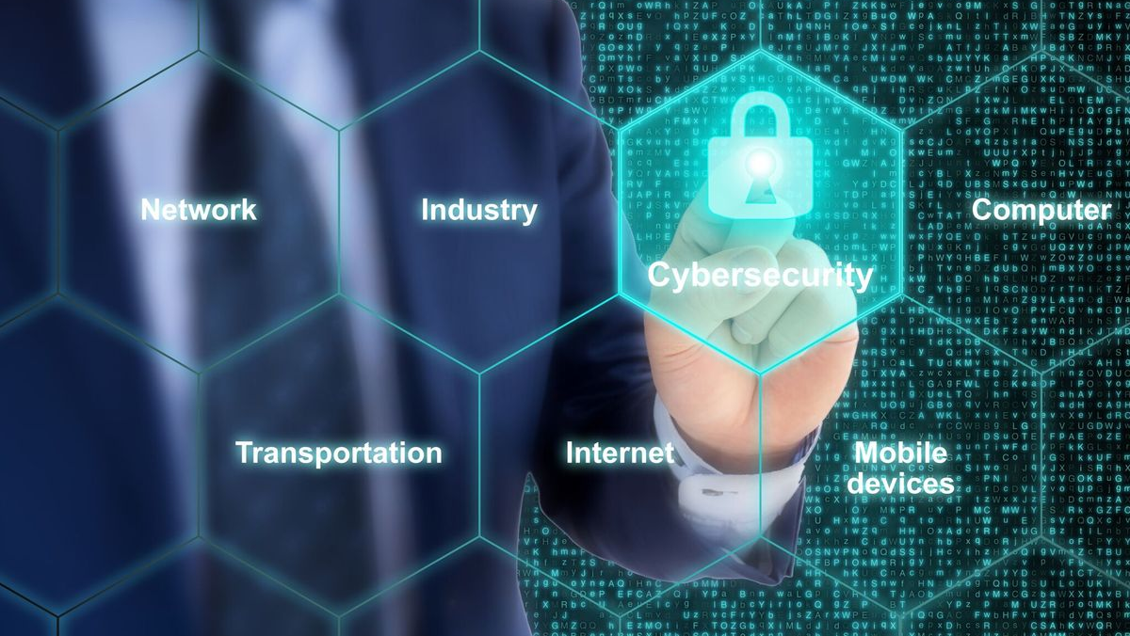
Cybersecurity Case Studies

Slide 2
* Target, 2013
* Ashley Madison, 2015
* US Office of Personnel Management, 2015
* Equifax, 2017
* TikTok, 2020
* YouTube, 2020
* AOL, 2021

Slide 3
A tale as old as Facebook…
Today’s tale isn’t about a failure of security at TikTok, per se. It is actually a failure of security brought about by the economics of big data and social media markets, and actually involves TikTok, YouTube, and Instagram that all sold customer information to a data broker called Social Data Trading Limited.

Slide 4
Social Data Trading Limited
This is a Hong Kong cased company that was incorporated in August of 2019.
They are a data broker that sells data on social media influencers to marketers. A common component in the eco-system of Big Data. Social media company has data, contracts broker to monetize it. Broker sells data to marketers. Markets sell ads or create campaigns based on those.
Social Data Trading Limited was also, evidently, part of the former company Deep Social – who worked with Instagram to scrape the site for influencer databases, using machine learning and facial recognition to derive insights.
This is news because Instagram was include din the 2020 breach, and when Deep Social went under, well…..

Slide 5
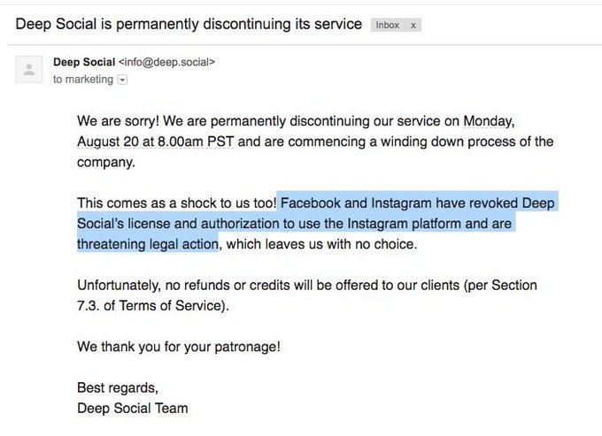

Slide 6
A clarification
The former CEO of Deep Social, Pavel Maurus, made clarifications about the incident.
While the Instagram datasets in this breach were on DBs names accounts-deepsocial-90 and accounts-deepsocial-91, the defunct Depp Social has no affiliation with Social Data Trading Limited.
It’s true that Social Data used a modified version of the same software as that used by Deep Social, but it might have been stolen by former Deep Social employees who now work for Social Data Trading Limited.
Social Data Trading Limited is a completely separate entity from Social Data Ltd., which shut down in January 2020.

Slide 7
Further clarification
Web scraping is using bots to copy down data from web pages in bulk. In this case, the data is publicly available.
Web scraping is also a violation of the ToS for most social media platforms, including TikTok, YouTube, and Instagram.
Scraping can be difficult to determine if done correctly, but this really gives the platforms the option to turn a blind eye until they have reason not to, and profit from the practice while providing legal impunity to both parties.
It should be noted that it’s also a handy way to circumvent those pesky privacy laws… They apply to the company – if someone comes along and scrapes that public data, well, what could they do? It’s out of their hands.

Slide 8
Such as:
SDTL: “Please, note that the negative connotation that the data has been hacked implies that the information was obtained surreptitiously. This is simply not true, all of the data is available freely to ANYONE with Internet access. I would appreciate it if you could ensure that this is made clear. Anyone could phish or contact any person that indicates telephone and email on his social network profile description in the same way even without the existence of the database. […] Social networks themselves expose the data to outsiders – that is their business – open public networks and profiles. Those users who do not wish to provide information, make their accounts private. [sic]”
Facebook Rep: “Scraping people’s information from Instagram is a clear violation of our policies. We revoked Deep Social’s access to our platform in June 2018 and sent a legal notice prohibiting any further data collection.”

Slide 9
Second verse, same as the first:
SDTL: "We collect data and enrich it with additional useful insights solely on behalf of our reputable customers, who use it strictly for the intended purposes. It is extremely sad that this incident has occurred due to a mixture of unfortunate events. However, as soon as we learned of the incident, we fixed it immediately. We have since been closely working with the information security experts on auditing our security infrastructure and increasing the required levels of information security to avoid similar occurrences in the future."
TikTok: "TikTok places the highest priority on user privacy, and we have anti-scraping policies in place. Our Terms of Service prohibit third parties from running automated scripts to collect information from our services, including public profile information. If we identify any such practices, we will take rapid action, including seeking legal redress."

Slide 10
What was taken
Well, turns out there is a lot of data loaded on the front-end that isn’t modeled in the browser. Even if set to private.
PII - Names, age, gender, phone, email, images, and statistics of follower engagement.
Three identical copies of the data.
96,714,241 records scraped from Instagram
95,678,713 records scraped from Instagram
42,129,799 records scraped from TikTok
3,955,892 records scraped from Youtube

Slide 11
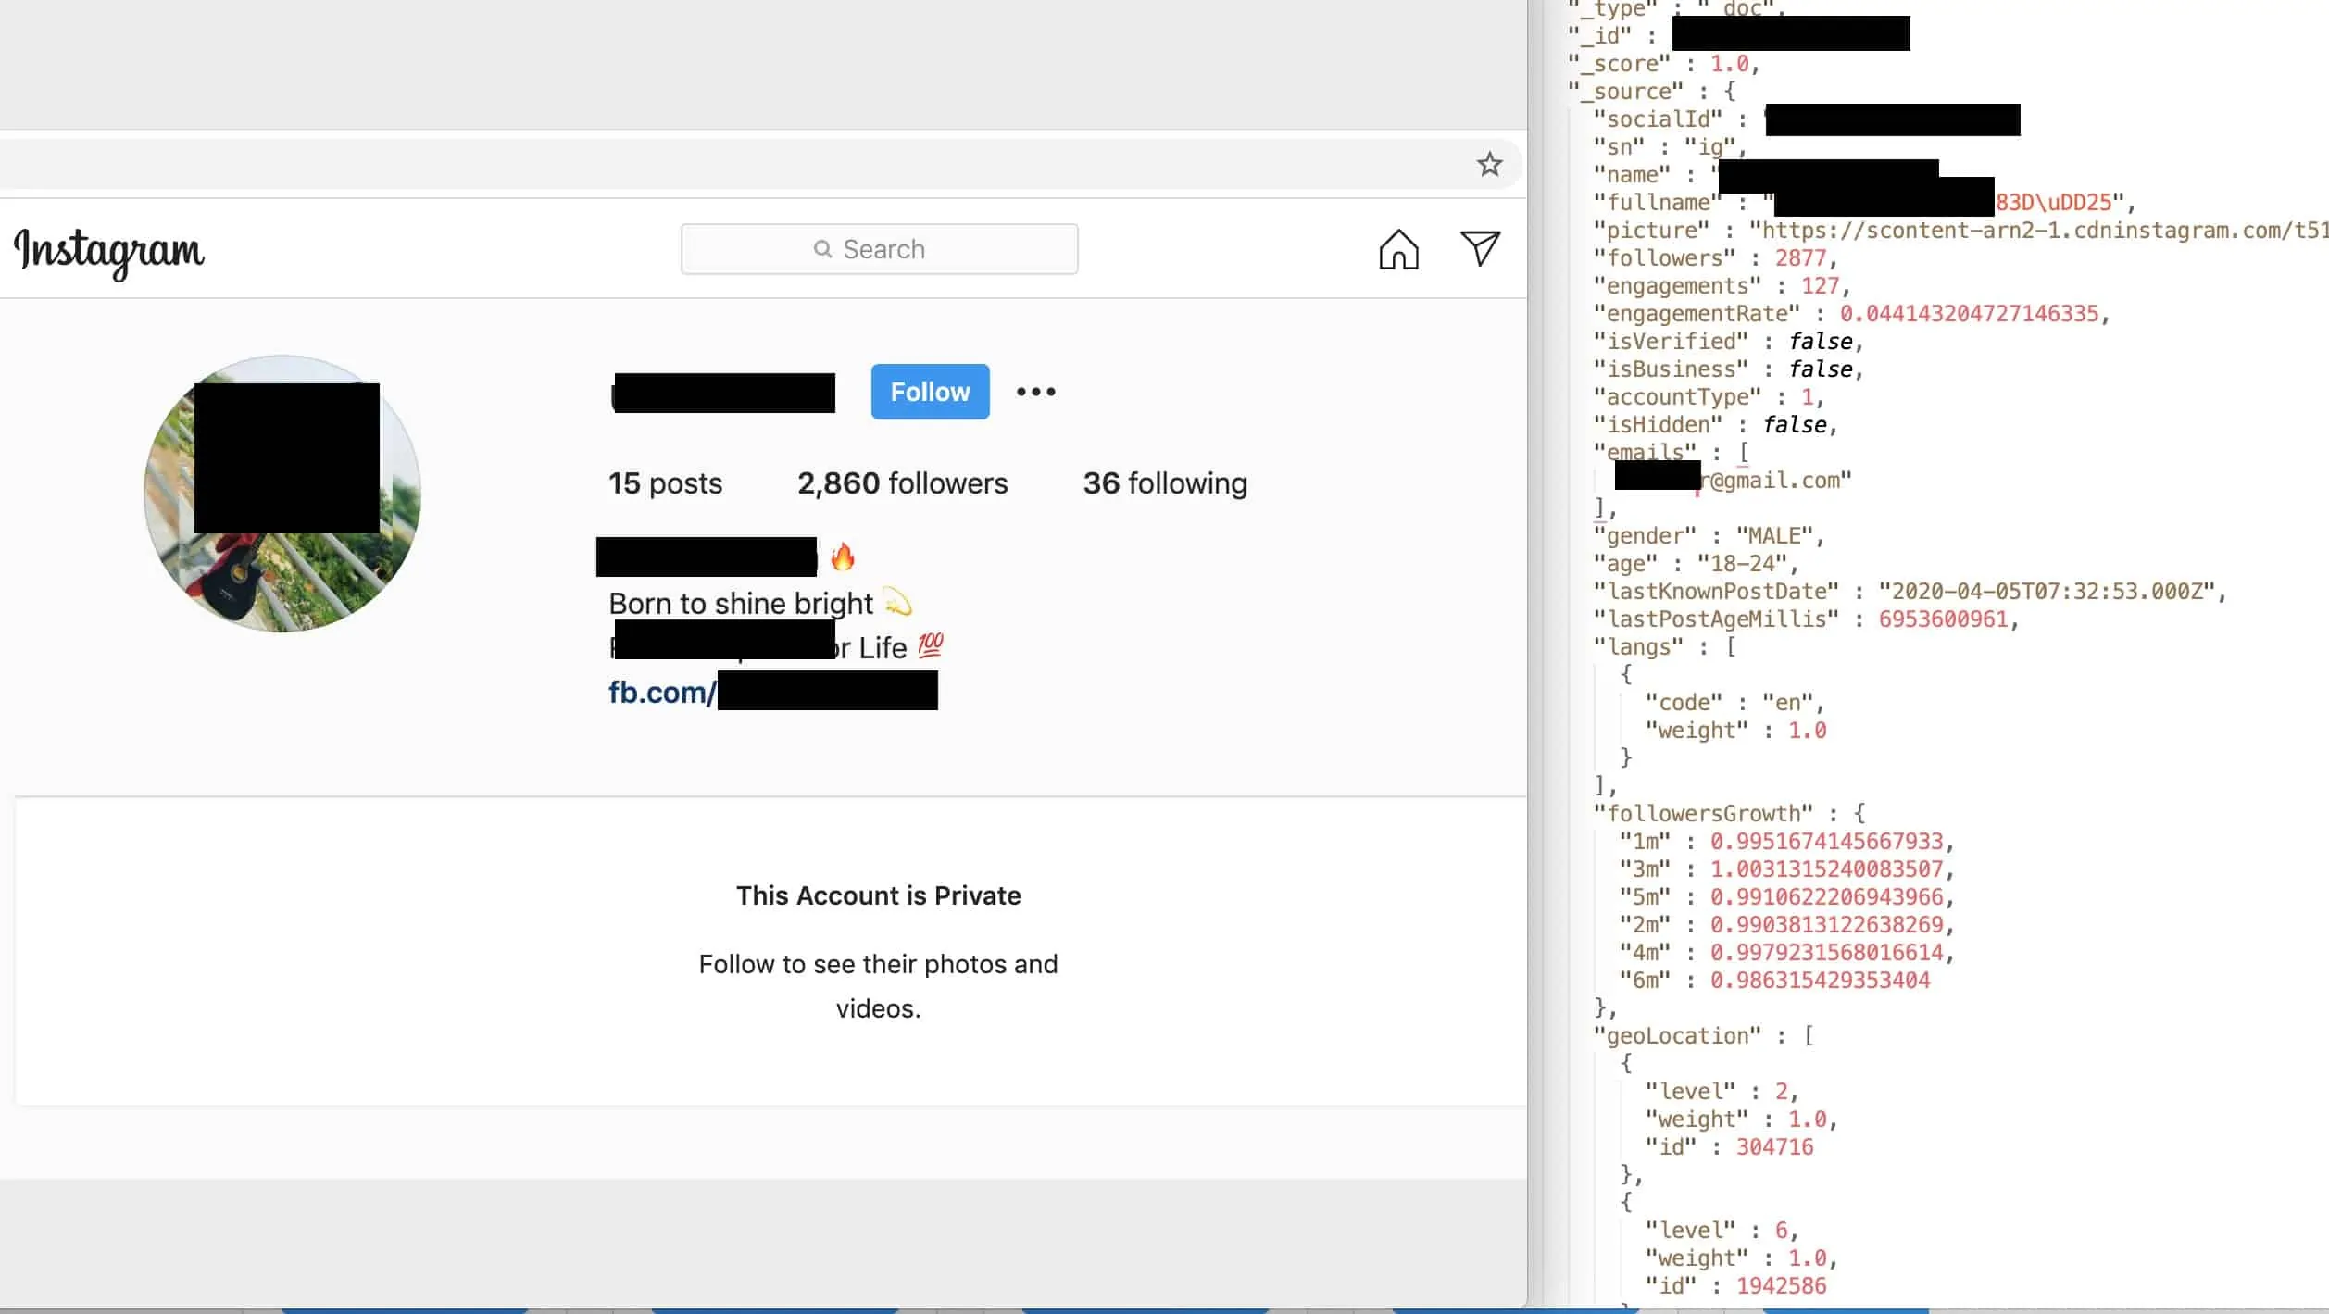

Slide 12
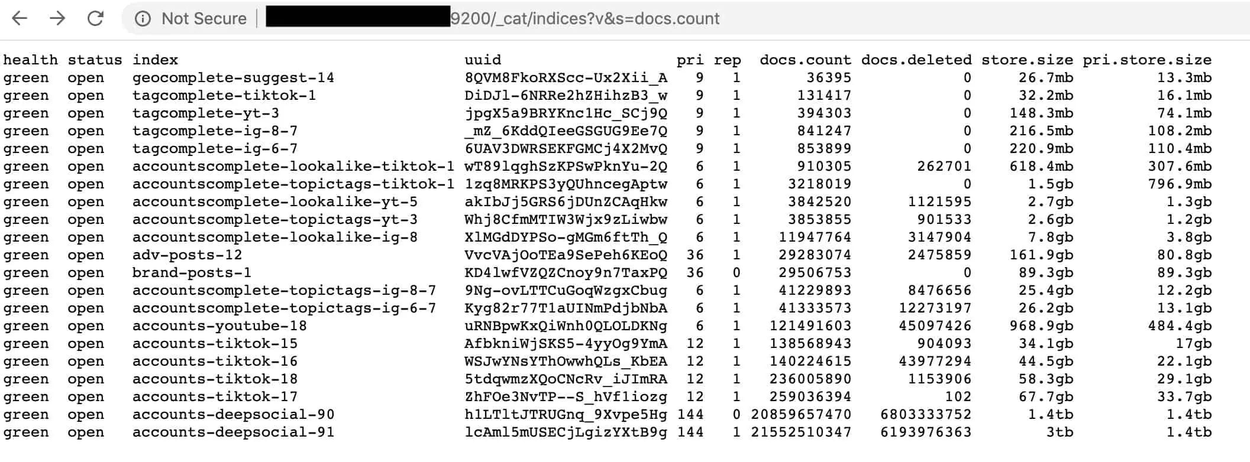

Slide 13
Piles of unsecured databases
One of the big problems with members of the big data ecosystem is that they simultaneously understand the value of data, and also tend to not care about securing it. This is not an usual scenario in any industry – complacency sets in.
In this case, the data was left on three unsecure databases accessible to anyone over the Internet.
The idea was probably that no one would find it, but research with honeynets shows unsecured databases are generally discovered and crawled within hours of being stood up and multiple times per day.

Slide 14
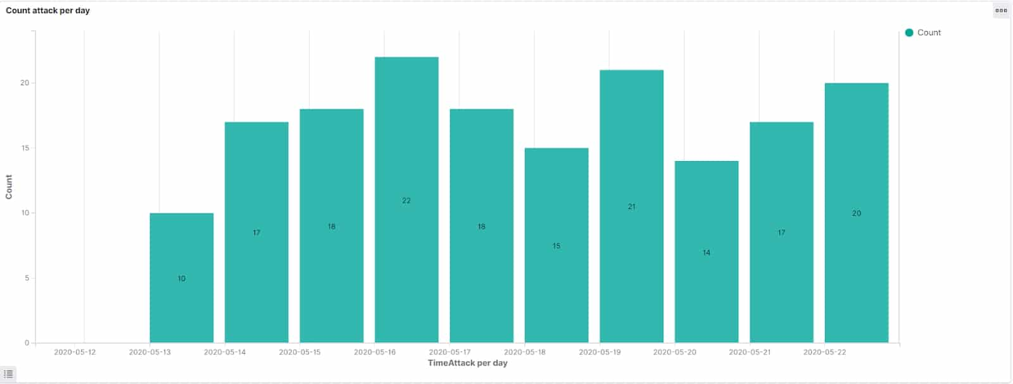

Slide 15
The problem for TikTok
While in this case they are legally indemnified from and wrongdoing on the part of Social Data Trading Limited, this wasn’t good for them.
It added fuel the fire of several ongoing lawsuits – more than 20 in all. One of these amalgamated into a class action lawsuit that was recently settled for $92 million.
This is particularly true of the lawsuits on behalf of minor victims… Clearly TikTok knew the age of subscribers. Clearly they collected data on them in violation of the law. (15 USC 6501 – COPPA)

Slide 16
Observe the following:
https://sg.style.yahoo.com/finance-sgtv/tiktok-influencer-bria-jones-potential-145250765.html
What do you think of Bria’s take re: data security?
What about her take re: platform sales/monetization of content by the platform?
What about her take on Trump’s ire being the result of a Gen Z uprising on the platform?
Bonus consideration – Camera’s and stuff.

